Slide 1
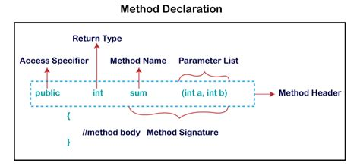
Methods

Slide 2

Check In
What learning looks like
Quiz 2 -
update and print your tech documentation
Student Loop Questions - answered
Goals
Examine Java defined methods
Explore how to create user defined methods
Return values and parameters
Calling methods and passing arguments
Understand scope and Stack frames

Slide 3

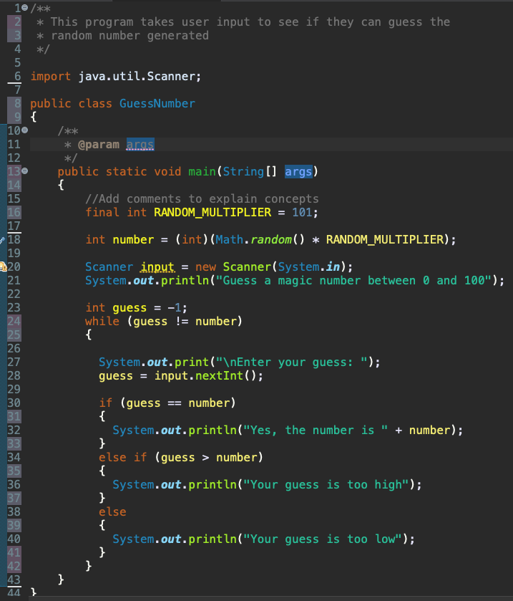

Java Program Chat
Celebrate how much you have learned
Open your technical document.
Give example from the code and brief description
Predefined class and method
How to add a class to use in your program
Create object - an Instance of a class
Method to read in information from the keyboard
Method that has a return value
Method that doesn’t have a return value
Method that has a parameter
Method that doesn’t have a parameter
Primitive data type
Non-primitive data type
Relational operator
Type of Algorithm used for the conditions
Warning that needs to be fixed
Scope of number variable
Scope of guess variable
How to implement conditions
How to repeat code

Slide 4


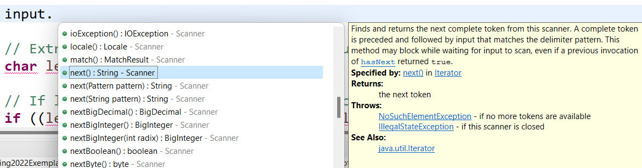
Review Predefined Methods in Java
We use predefined methods to reuse code and break our problem into smaller tasks.
System.out.println() is a method in the System class to display information.
What parameters does the method need passed to it to do the task?
What does the method return?
next() is a method in the Scanner class to read a string
What does the method need passed to it to do the task?
Explore the charAt() string method. What parameters are needed and what returns? If any?

Slide 5
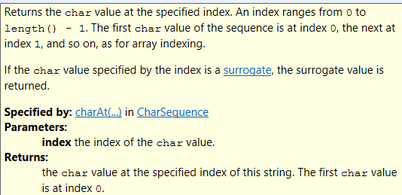


Method Parameters and Return Data Types
The number, order, and type of values passed in must match the number, order, and type of the parameters declared in the method
Notice these errors when using charAt() method and the parameter or return types do not match.
Return type needs to be a char
Parameter Passing int
Char Return matches
Value for parameter needs to be an int

Slide 6
Methods
Purpose
Provides a way to organize and simplify code
Once code is in a method it can be called many times so do not repeat code
Improves code quality!
Breaking code into units makes it easier to plan, code, test and modify
Just like when you use java predefined methods A method may or may not return a value
A method must declare a return type!
If a method returns a value
returnType in this case is the data type of the value being returned by the method
the return statement is used inside the method to return the value
If a method does not return a value
returnType in this case is void
no return statement inside the method is needed

Slide 7
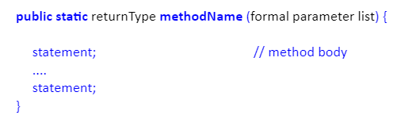
Define Methods
Define your own methods to do a task. Need to think about the following just like the java predefined methods API explains.
What the method does
What to name the method
Meaning full verb, begin with lowercase and use camelCase
What parameters are needed (if any)
What value it returns (if any)
General form
public - makes method's access public - this means visible to all classes
static - static methods belong to a class – for now make methods static
returnType - data type for value that is returned (int, double, boolean, etc.) or void (nothing to return)
methodName - a user defined name
formal parameter list - information that is coming into the method
method signature: return value method name (parameters)

Slide 8
Explore How Methods are Created
public class TestVoidMethod {
public static void main(String[] args) {
System.out.print("The grade is ");
printGrade(78.5);
System.out.print("The grade is ");
printGrade(59.5);
}//end main method
public static void printGrade(double score) {
if (score >= 90.0) {
System.out.println('A');
}
else if (score >= 80.0) {
System.out.println('B');
}
else if (score >= 70.0) {
System.out.println('C');
}
else if (score >= 60.0) {
System.out.println('D');
}
else {
System.out.println('F');
}//end multi way if
}//end max method
} //end TestVoidMethod Class
Open TestMax returns int
Open TestVoidMethod
c
l
ass
public class TestMax {
/** Main method */
public static void main(String[] args) {
int i = 5;
int j = 2;
int k = max(i, j); // Invoke max method
System.out.println("The maximum between " + i +
" and " + j + " is " + k);
}//end main method
/** Return the max between two numbers */
public static int max(int num1, int num2) {
int result;
if (num1 > num2) {
result = num1;
}
else {
result = num2;
}
return result; // Return result
}//end max method
}//end TestMax Class
m
ain
max

Slide 9
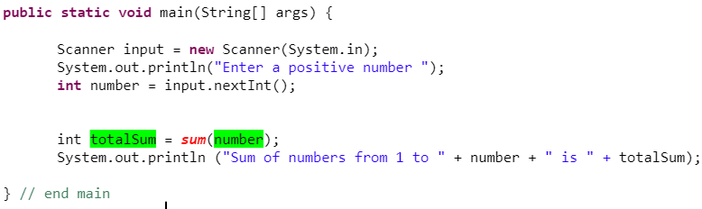
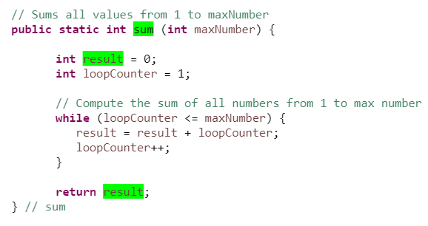
Create Sum Method with Parameter and Return Value
Example of calling the method that has a parameter and a return value from main.
Pass argument (copy of what is in memory for number) with same datatype
Return result and assign to totalSum memory location
When a value is returned:
Method must specify the type of value it returns in the return type
A return statement inside the method is required
The return statement is the point at which control returns to the caller and normally the last statement in the method.
The value returned by the method should be stored in a variable by the code that called the method.
When method is called and a value is passed.
The parameter is variable that is declared in memory and initialized with a copy of the value

Slide 10
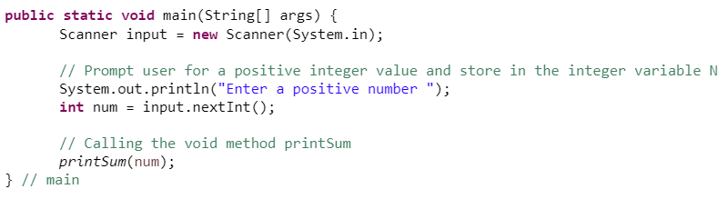
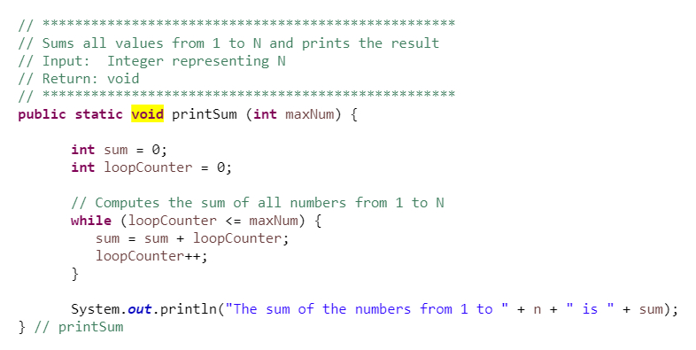
With Parameter and No Return Value (Void method)
Example of calling the method that has a parameter and no return value from main.
main returns void, no return value at end of main
No return value so no variable needed
Void is needed to define that there is not a return value
When no value is returned:
The return type must be set to void
No return statement is used
Control returns to caller when the methods closing curly brace is reached
No return statement

Slide 11

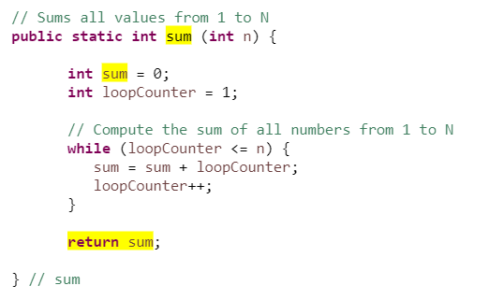
Sum Method Example
Method sums all the values from 1 to maxNumber
Do not use variables names in the method that are the same as the method name.
Notice the name of the sum function and the variable result is different.
What is another way to sum the numbers?

Slide 12
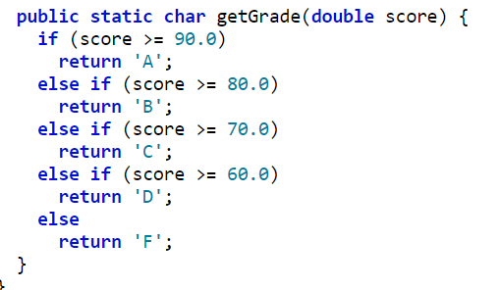

One Return Value
When creating your methods you should use only one return value.
public static char determineLetterGrade(double finalGrade){
char letterGrade = ' ';
if (finalGrade >= 90){
letterGrade = 'A';
} else if (finalGrade >= 80){
letterGrade = 'B';
} else if (finalGrade >= 70){
letterGrade = 'C';
} else if (finalGrade >= 60){
letterGrade = 'D';
} else{
letterGrade = 'F';
}
return letterGrade;
}
Do not use multiple return values in your methods.
Remember to use { } to show where the block of code starts and ends

Slide 13
Preparation
Go to canvas and submit participation.
Then decide what you want to work on
Prepare for quiz
Go to Module 02 objectives and see if you can write examples and explain
Practice writing code again
Practice writing the output of code from lectures
Update your documentation and print for the quiz
Work on GE03
Tips
copying and pasting code into word document and google document from Eclipse
Study groups

